Slide 1
CLI Employee Management System
https://github.com/paulchinnam/Java_HRIS_System
Team 4: Paul Chinnam, Joseph Huntley, Cedric Patton

Slide 2
Discussion Topics
Paul: Project objective, planning, & management
Joseph: Database structure
Cedric, Paul, & Joseph: Implemented classes & source code
Cedric: Live demo
Paul: Future improvement (GUI)
Questions

Slide 3
Project Objective
HRIS application for McMillan & Associates
Performs basic CRUD actions
Java frontend
MySQL backend
Notes:
Goal was to build an hris application for fictitious corporation McMillan & Associates
HRIS app maintains, manages, processes wide range of employee information and relevant policies/procedures
Basic HRIS app performs basic CRUD
Other requirements - frontend built in java, backend built with MySQL

Slide 4

Driver Menu

Slide 5

Employee Menu

Slide 6

Manager Menu

Slide 7
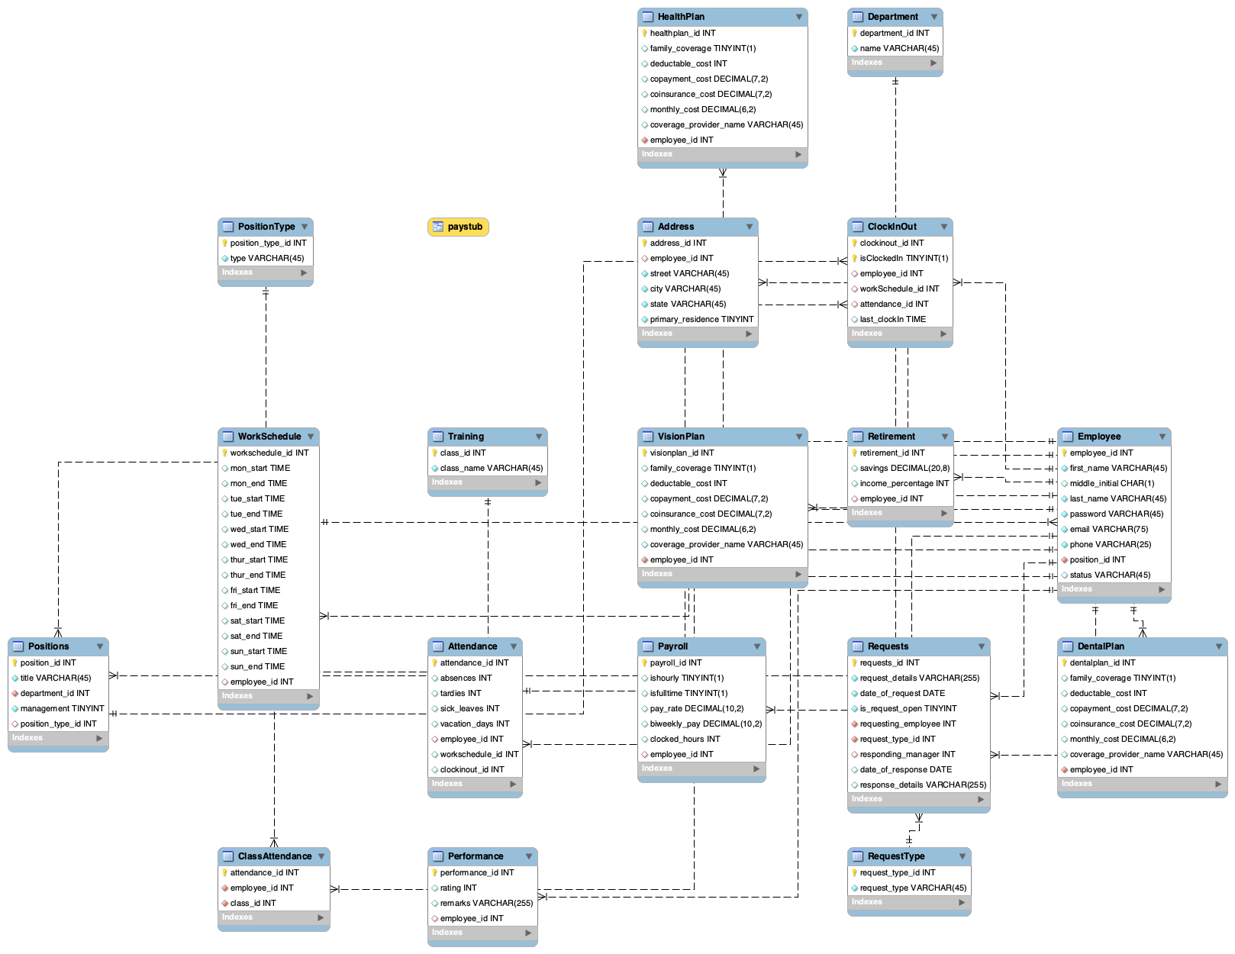
Database Schema
18 tables
5 employee tables
4 benefits tables
4 attendance tables
5 business operations tables
Paystub View
Notes:
Our DB consists of 18 tables, which are broken down on the slide. Some of these tables may seem excessive, but every table in our database has a specific purpose. Similar to modularization in java, we broke these tables down into individual functions to increase the ease of maintenance and future upgradability. As you can see on our Entity Relationship Diagram on the right, many of the tables are connected to the employee table in some way. Our db also includes a single view, on the ER Diagram our view is depicted as a single golden box. A view is similar to a table in that they both store data, the main difference is that views don’t store their own unique data, instead they are built of data from multiple tables. In our case our view is built from data regarding an employee’s paystub. Finally, our DB contains dummy data so that when we test our application we can see the results in our DB.
Five Employee info
Employee
Address
Positions
PositionType
Performance
Four tables for benefits
Health Plans
Dental Plans
Vision Plans
Retirement
Four tables regarding attendance
Attendance
WorkSchedule
ClassAttendance
ClockInOut
Five tables devoted towards the business
Payroll
Training
Department
Request
RequestType
Paystub view
EmpID
Pay Rate
Hours worked
Benefit Deductions
Net Pay
200 fake employees

Slide 9
Package Structure
Contains 4 classes
FinalProject (Driver class)
Database
EmployeePriviledges
ManagerPriviledges
Prepared statements reinforce referential integrity

Slide 10
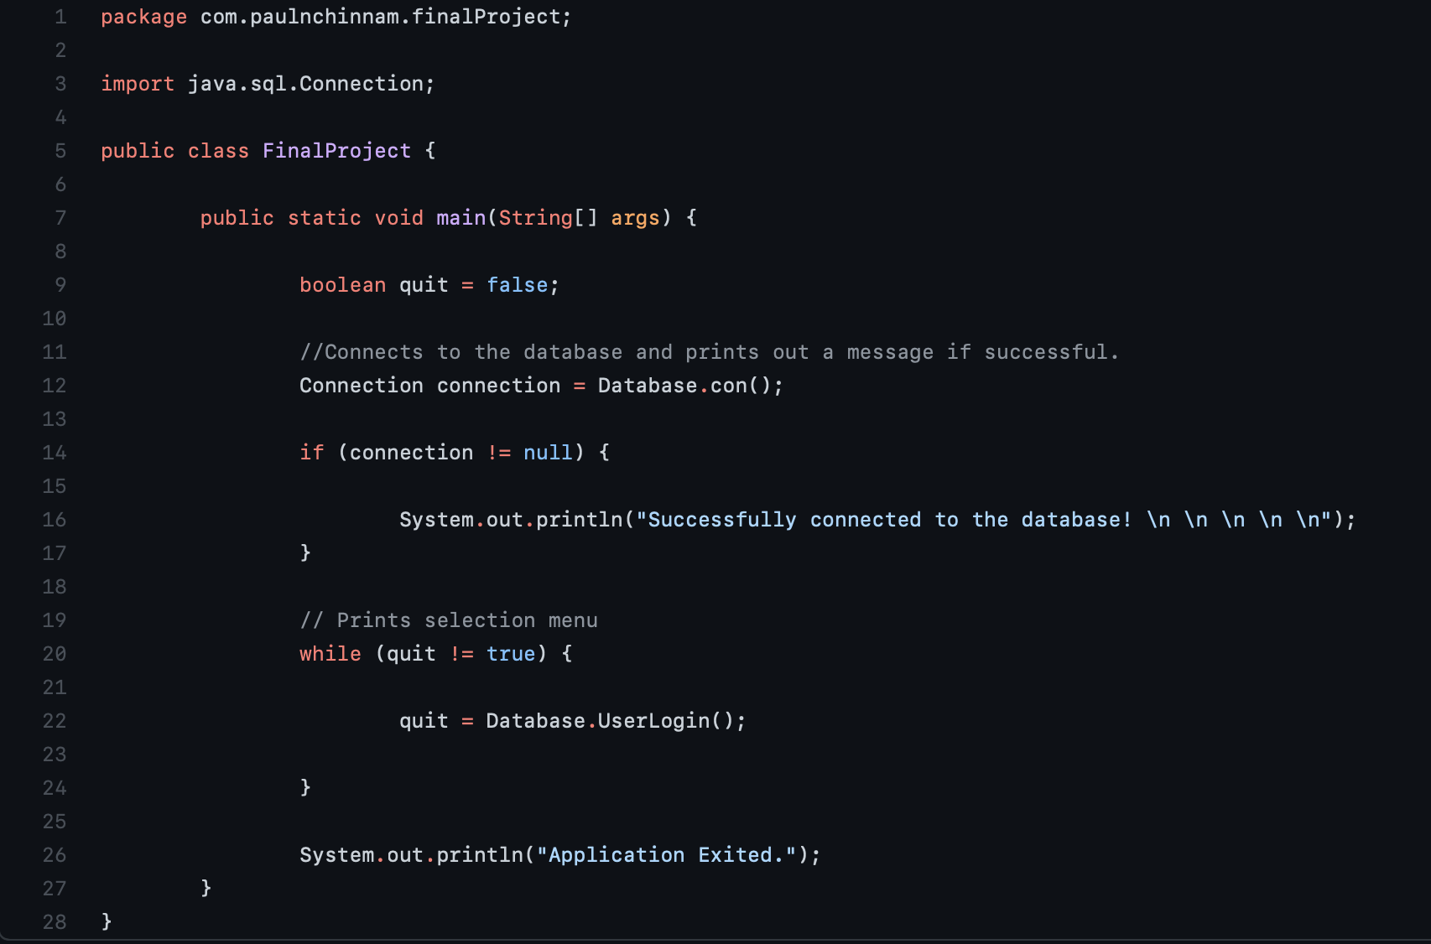
FinalProject
Drives the program
Imports java.sql.Connection
Methods
Main method

Slide 11
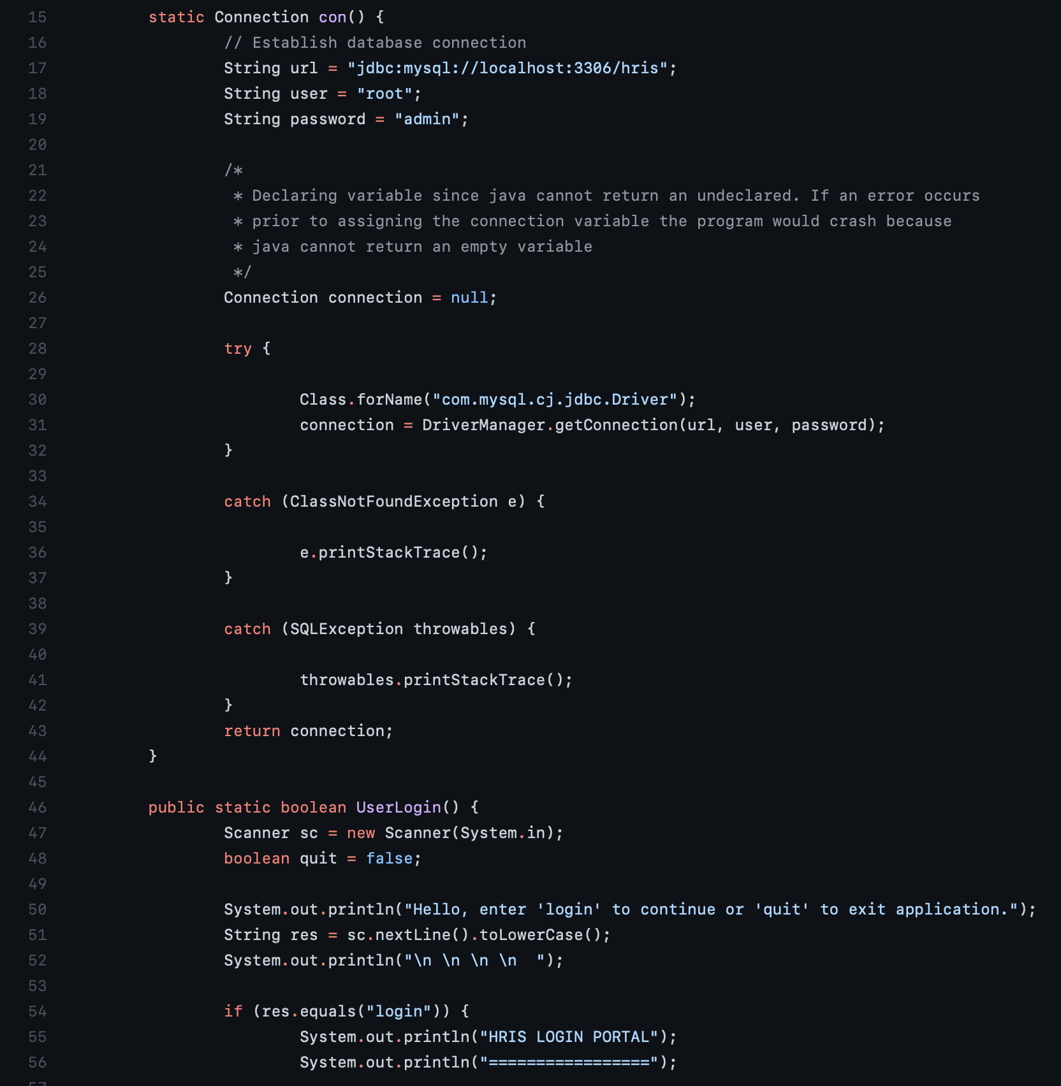
Database
Establishes DB connection
Implements login feature
Imports
java.sql
java.security
java.util.Scanner
java.math.BigInteger
Methods
con()
userLogin()
managerPrompt()
employeePrompt()
sha1Hash()
displayEmployee()

Slide 12
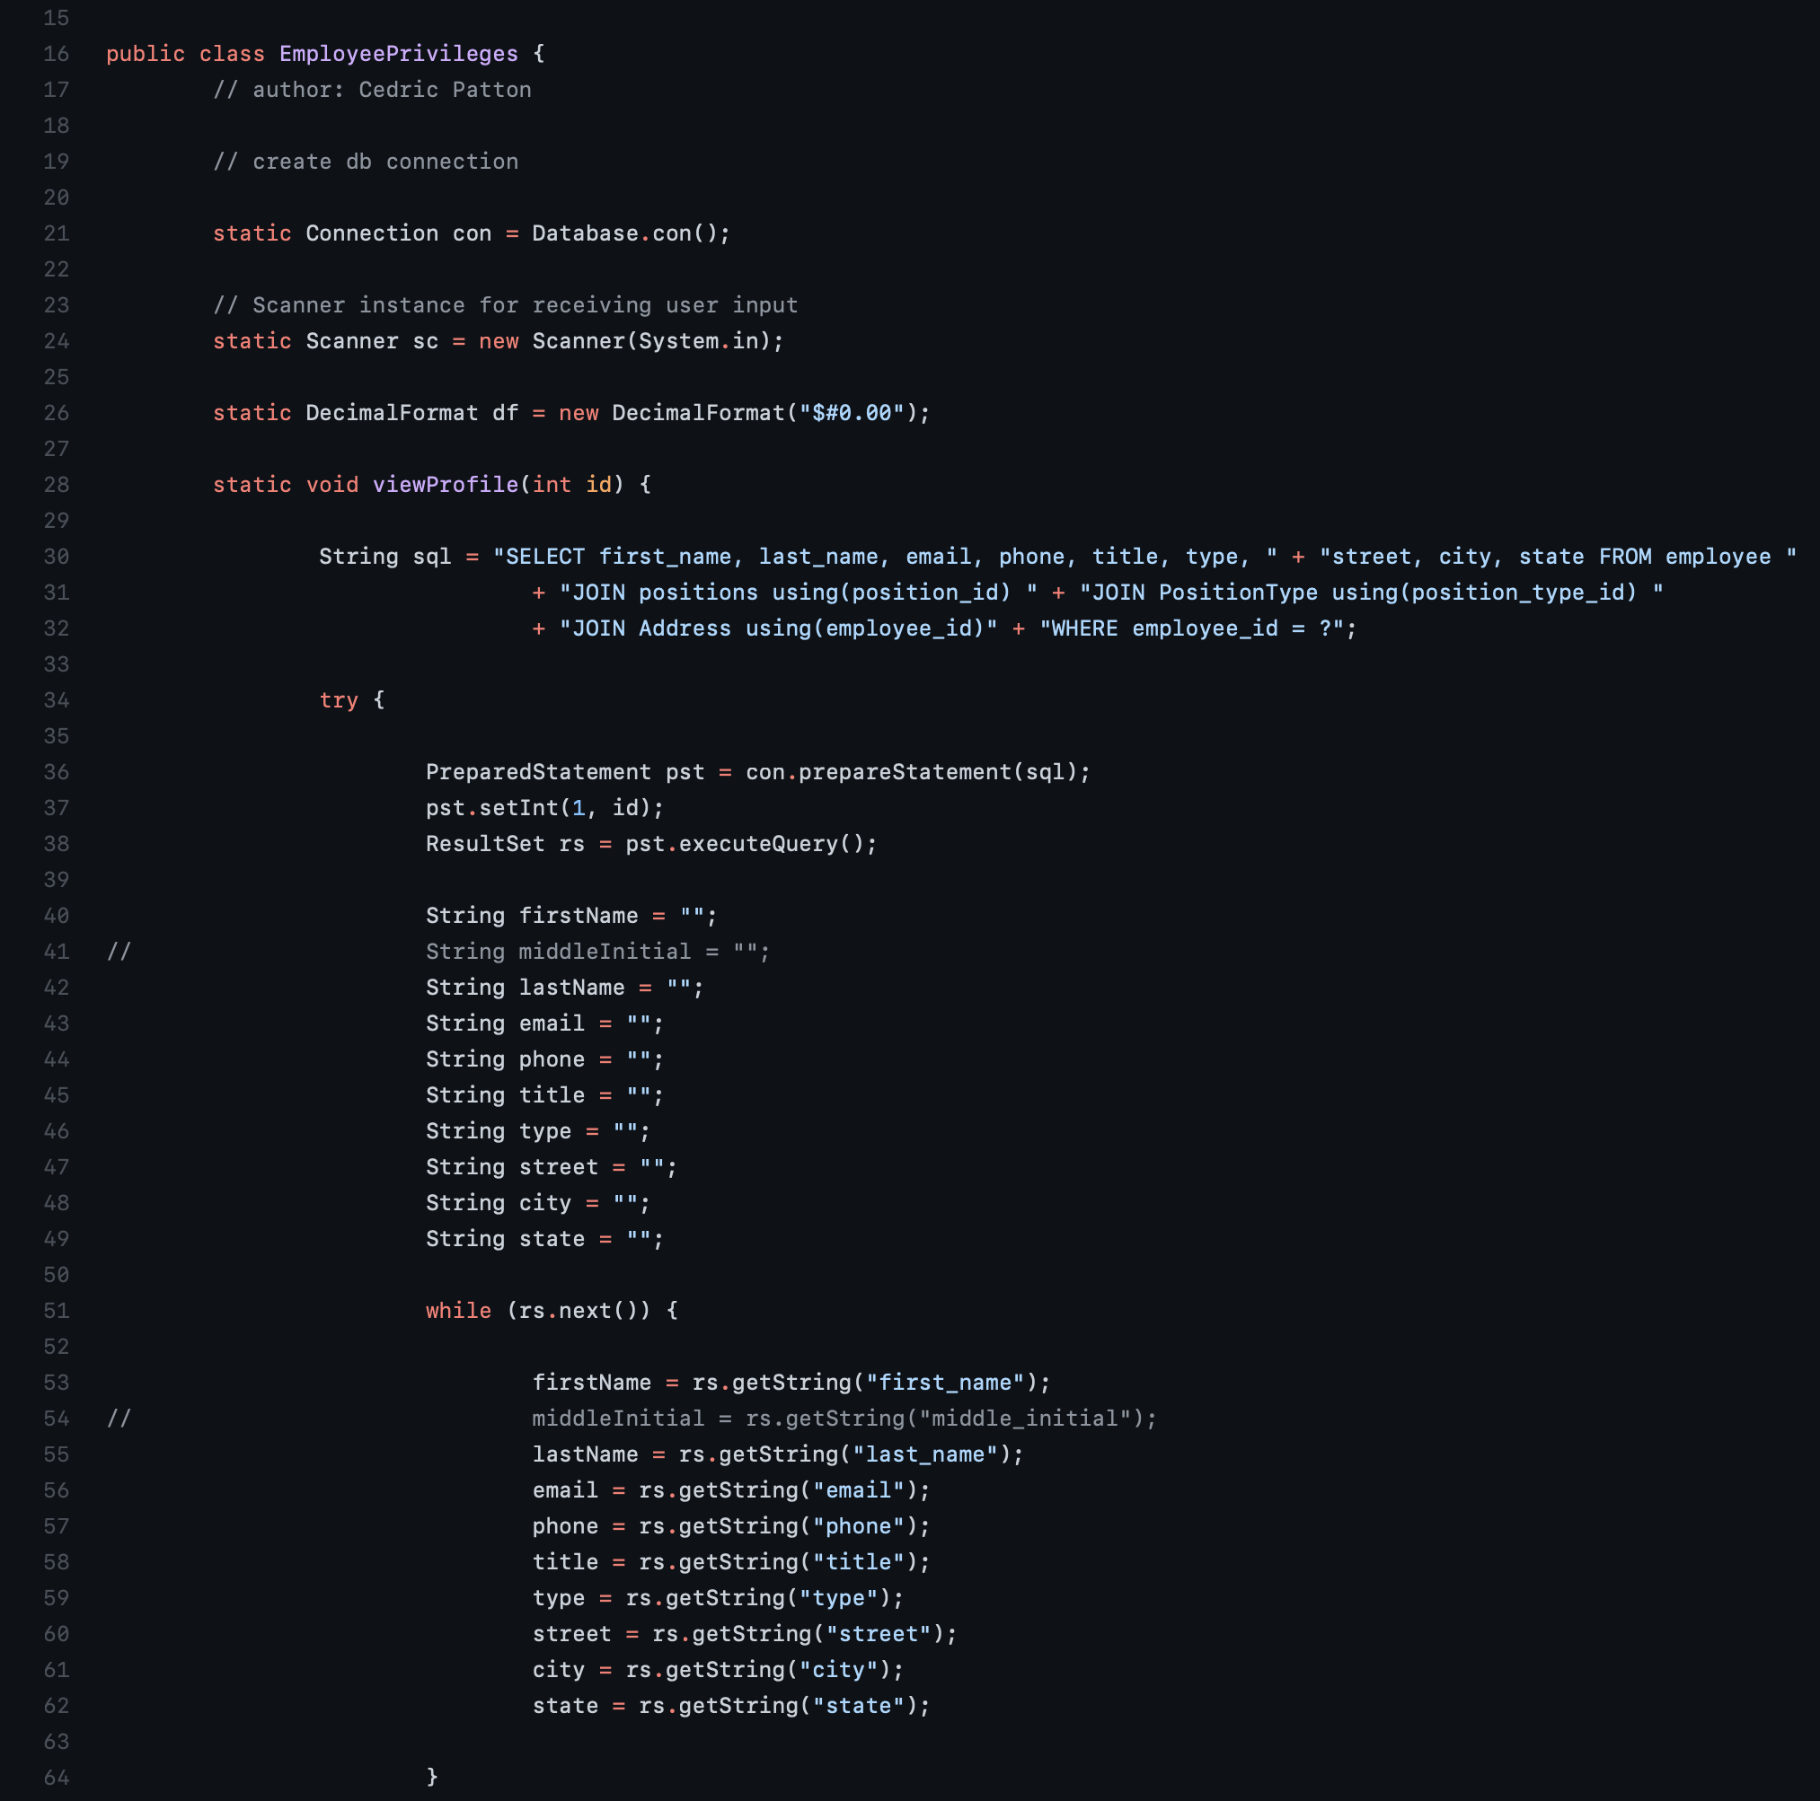
EmployeePriviledges
Displays employee menu
Only employee level actions
Imports
java.sql.*
java.time.*
java.util.Scanner
java.text.DecimalFormat
Methods
viewProfile()
updateProfile()
viewPerformance()
viewBenefits()
viewSchedule()
viewPaystub()
clockInOut()
handleRequests()

Slide 13
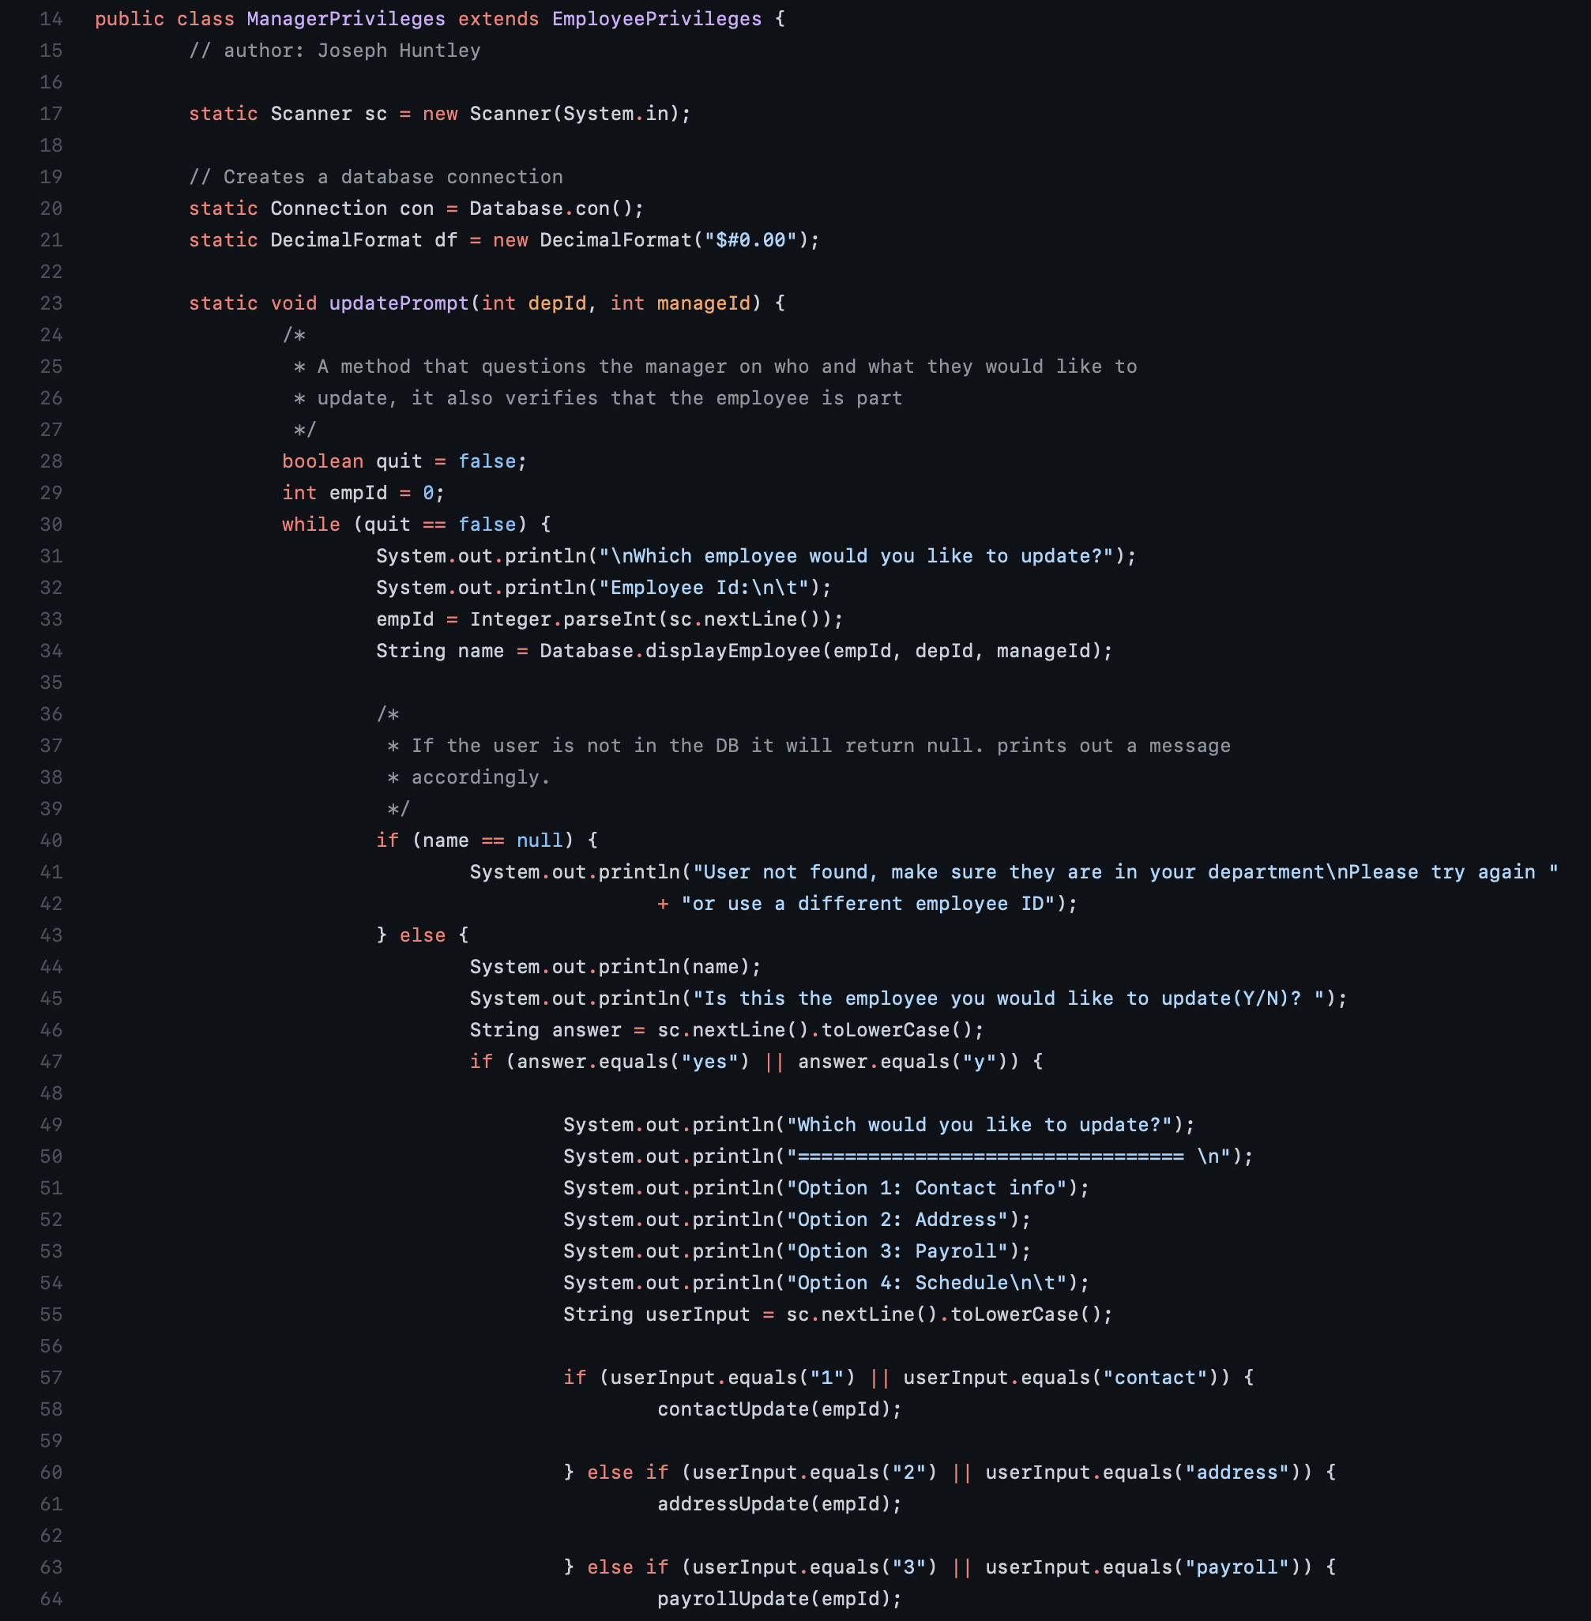
ManagerPriviledges
Displays manager menu
Only manager level actions
Imports
java.sql.*
java.time.*
java.util.*
java.text.DecimalFormat
Methods
updatePrompt()
contactUpdate()
addressUpdate()
payrollUpdate()
scheduleUpdate()
addEmployee()
performanceReport()
readPrompt()
deleteEmployee()
empRequest()

Slide 14
Live Demo

Slide 15

GUI
MVC structure
Model
MySQL
View
React.js
Controller
Spring

Slide 16
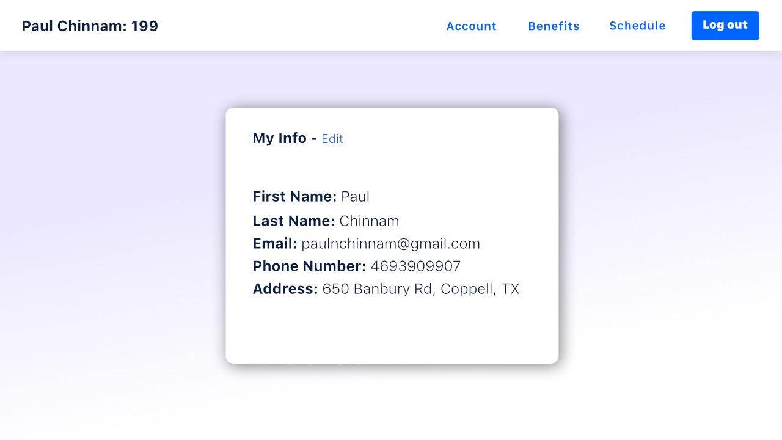
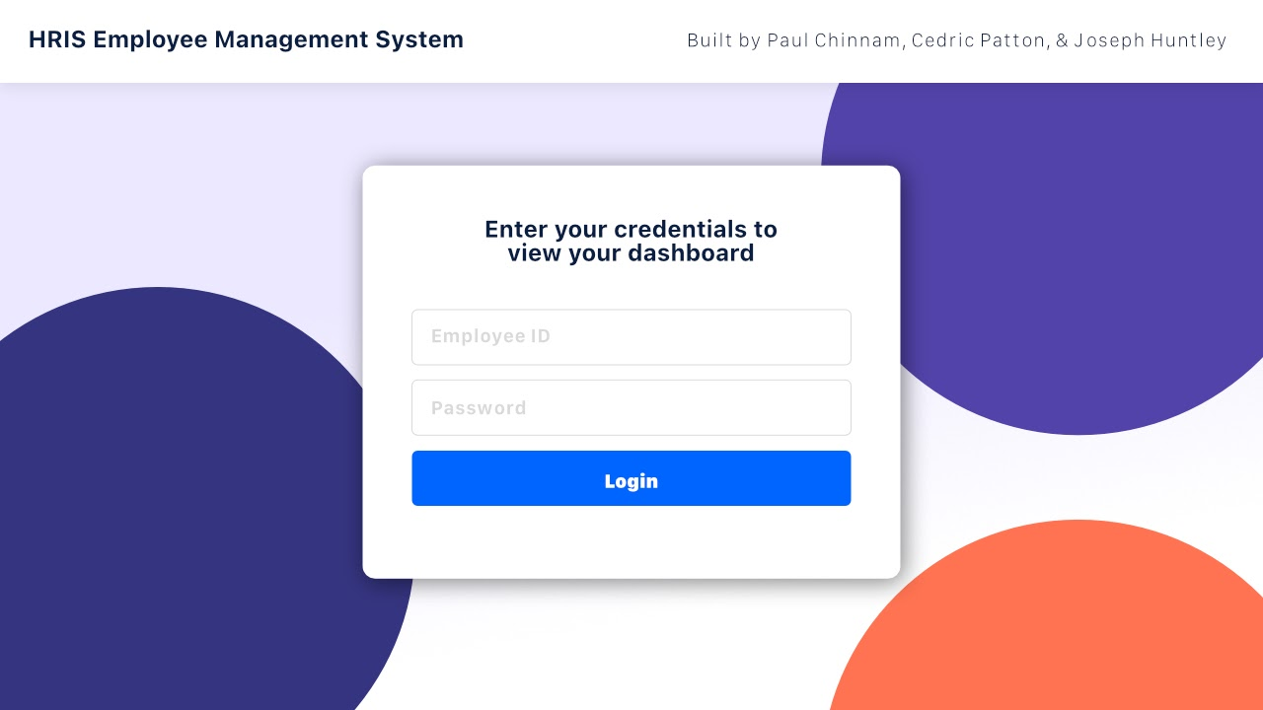
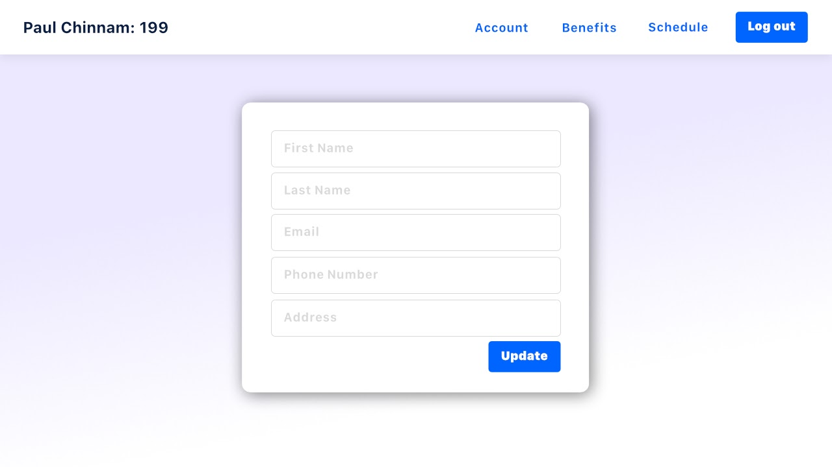

Slide 17
Questions

